Slide 1

Linear Regression
Mentors:
~Anupama Kolsur
~Surabhi
~Shipra Mathur
~Rishik

Slide 2


Introduction:
Linear Regression is a supervised machine learning algorithm where the predicted output is continuous and has a constant slope.
It’s used to predict values within a continuous range.
Eg. Sales, price
There are two main types:
Simple regression
Multivariable regression

Slide 3
Equation of Simple Linear Regression
Mathematically, regression uses a linear function to approximate (predict) the dependent variable given as:
Y = βo + β1X + ∈
where, Y - Dependent variable
X - Independent variable
βo - Intercept
β1 - Slope
∈ - Error
βo and β1 are known as coefficients.

Slide 4
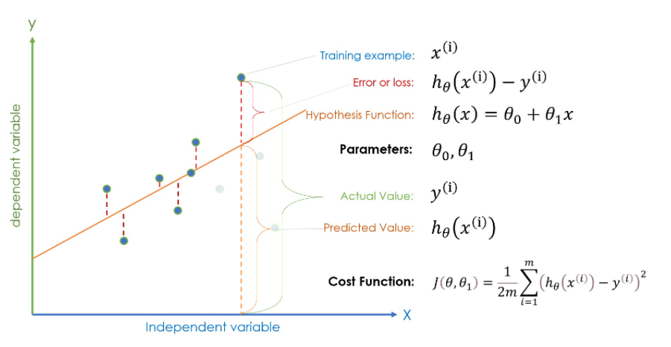

Slide 5

Cost Function
This takes an average difference of all the results of the hypothesis with inputs from x's and the actual output y's.
This function is otherwise called the "Squared error function", or "Mean squared error".

Slide 6

Gradient Descent
Gradient descent is an optimization algorithm used to find the values of parameters (coefficients) of a function (f) that minimizes a cost function (cost).
Gradient descent is best used when the parameters cannot be calculated analytically (e.g. using linear algebra) and must be searched for by an optimization algorithm.

Slide 7
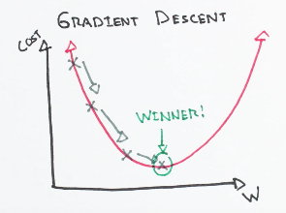
Intuition for gradient descent
Assume a valley. A random position on the surface of the valley is the cost of the current values of the coefficients (cost).
The bottom of the valley is the cost of the best set of coefficients, the minimum of the function.
The goal is to continue to try different values for the coefficients, evaluate their cost and select new coefficients that have a slightly better (lower) cost such that we reach the local minimum.
Repeating this process enough times will lead to the bottom of the valley and you will know the values of the coefficients that result in the minimum cost.

Slide 8
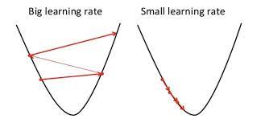
The size of these steps is called the learning rate. With a high learning rate we can cover more ground each step, but we risk overshooting the lowest point since the slope of the hill is constantly changing. With a very low learning rate, we can confidently move in the direction of the negative gradient since we are recalculating it so frequently. A low learning rate is more precise, but calculating the gradient is time-consuming, so it will take us a very long time to get to the bottom.

Slide 9
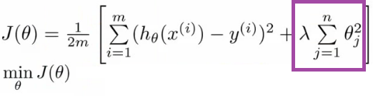
Overfitting and regularization
In supervised machine learning, models are trained on a subset of data aka training data. The goal is to compute the target of each training example from the training data.
Now, overfitting happens when model learns signal as well as noise in the training data and wouldn’t perform well on new data on which model wasn’t trained on.
Regularization basically adds the penalty as model complexity increases. Regularization parameter (lambda) penalizes all the parameters except intercept so that model generalizes the data and won’t overfit.
In above gif as the complexity is increasing, regularization will add the penalty for higher terms. This will decrease the importance given to higher terms and will bring the model towards less complex equation.

Slide 10
Resources
https://www.analyticsvidhya.com/blog/2020/10/linear-regression-for-absolute-beginners-with-implementation-in-python/
https://www.hackerearth.com/practice/machine-learning/machine-learning-algorithms/beginners-guide-regression-analysis-plot-interpretations/tutorial/
https://youtube.com/playlist?list=PLblh5JKOoLUIzaEkCLIUxQFjPIlapw8nU
https://www.coursera.org/learn/machine-learning/home/welcome

